Slide 1
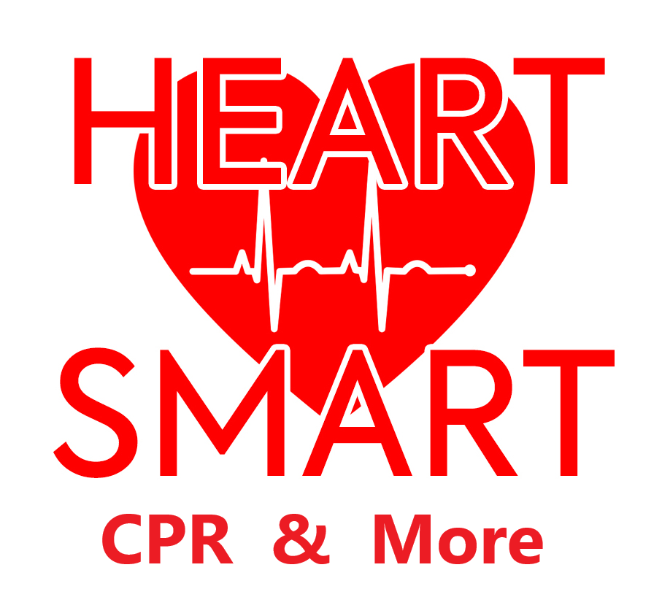
ECG Review
HeartSmartACLS.com

Slide 2
Cardiac Conduction
The heart is composed of three specialized cells. Pacemaker, Purkinje, and Contractile. Pacemaker cells have automaticity that undergo spontaneous electrical depolarization that initiates an electrical impulse. The Purkinje cells conduct electrical impulses more quickly than other cells, and the Contractile cells compose the majority of the heart and contract when the electrical depolarization reaches them.
Typically, the impulses begin in the SA node then travel through the atrial myocardium to the AV node. A fibrous ring, called the annulus fibrous, insulates the atria and ventricles from one another. This leaves the AV node as the only electrical pathway.
The distal continuation of the AV node is the Bundle of His, which is composed of Purkinje cells and travels down the septum and separates into the left and right Bundle Branches in the ventricles.

Slide 3
P wave – atrial depolarization/contraction R wave – ventricular depolarization/contraction T wave – ventricular repolarization/relaxation

Slide 4
Rhythm Analysis

Slide 5
Normal – conduction is working perfectly Brady – normal in athletes, can indicate ICP, toxins/drugs, hypothermia, vagal response, inferior wall MI

Slide 6
Can be due to exercise, fear, pain, hypotension, hypovolemia, anemia, hypoxia, hypoglycemia, MI, heart failure, OTC cold meds

Slide 7
Possible causes are underlying heart disease, cardiomyopathy, pericarditis, heart failure, ETOH

Slide 8
Reentry creates a loop of electrical impulses, usually preceded by a PAC Atrial tachycardia can be caused by an ectopic atrial focus

Slide 9
A rapid fire (irritable) automatic focus can cause unsustained “run of V-tach” or a sustained tachycardia that can degenerate into V-fib

Slide 10
Both can be caused by multiple irritable focuses, however, the true etiology of V-fib is unknown

Slide 11
Coarse V-fib depletes energy and progresses to Fine V-fib to Asystole Fine V-fib can be hard to distinguish from Asystole

Slide 12
PEA has organized electrical impulses with no mechanical capture, usually due to hypoxia, hypovolemia, acidosis, toxins, tamponade, blood clots

